Slide 1


EAGER: Model-based Foundations of
Collective Systems Design Theory
P. T. Grogan (PI) and A. Valencia-Romero (RA)

Slide 2

This study is brought to you by…
EAGER Award #1742971
PI: Paul T. Grogan
Sep 1, 2017 – Aug 31, 2018

Slide 3
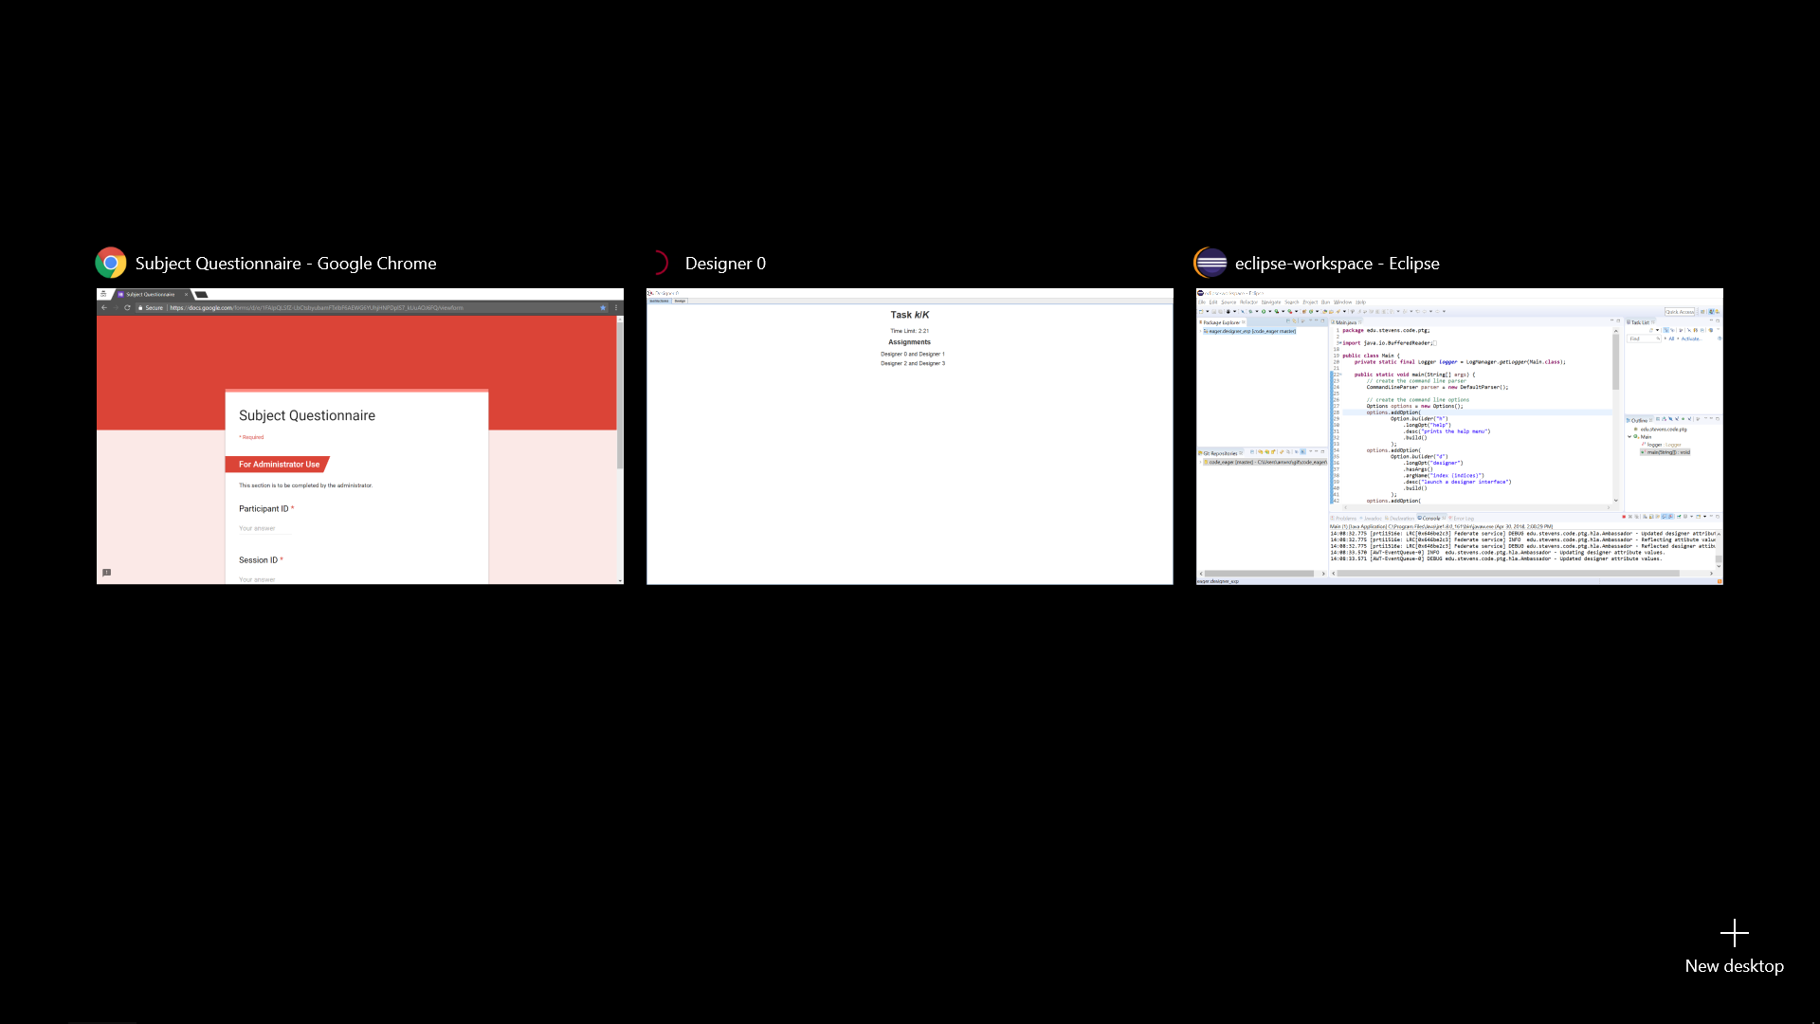


QUESTIONNAIRE
DESIGNER UI
DO NOT TOUCH!
+

Slide 4
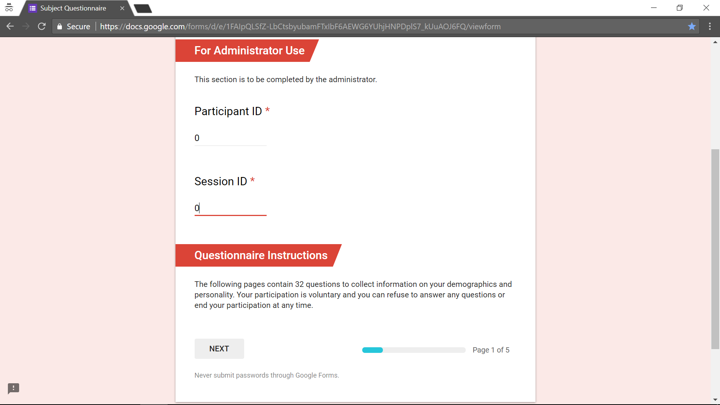
ALREADY FILLED
CLICK NEXT

Slide 5

QUESTIONNAIRE
DESIGNER UI
DO NOT TOUCH!

Slide 6
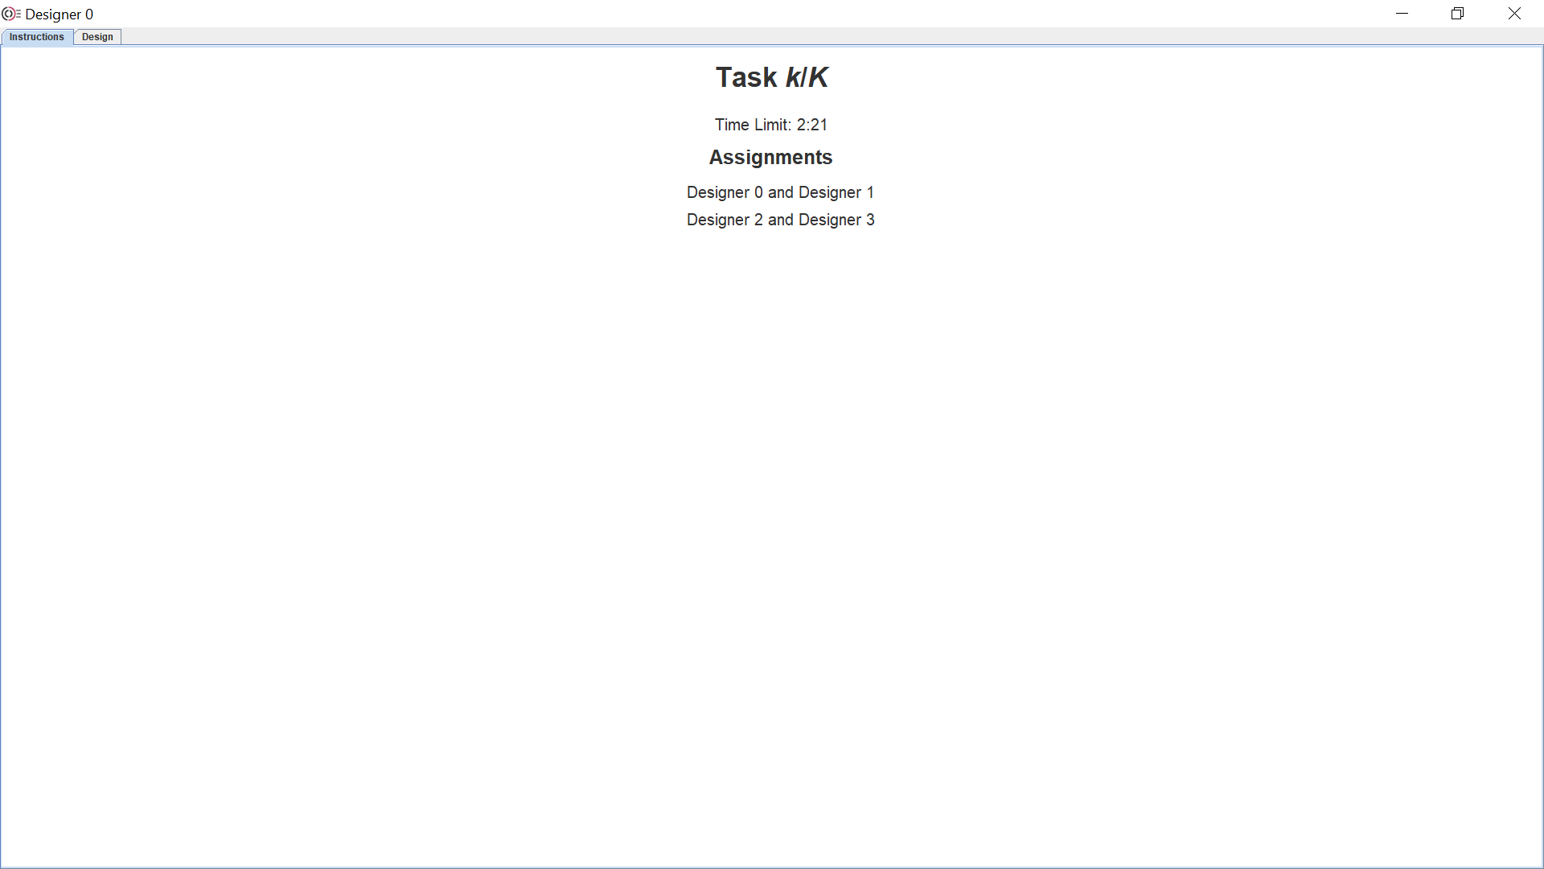

Total # of tasks
Federation #1
Federation #2
Total task duration

Slide 7






Task k/K
#
#
A
C
B
D
#
#

Slide 8
Training 1/3
0
2
A
C
B
D
1
3

Slide 9
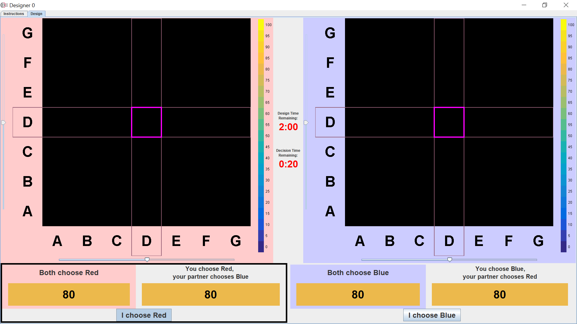

Slide 10
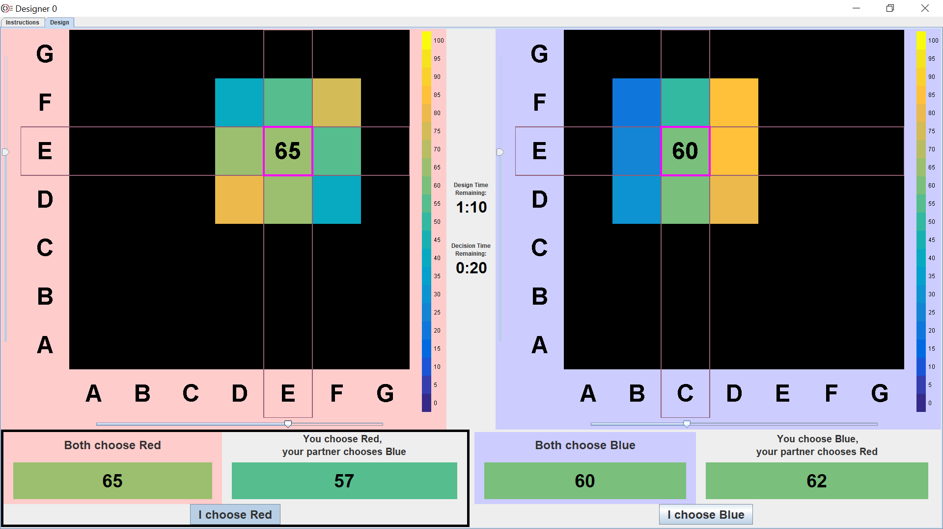

Slide 11
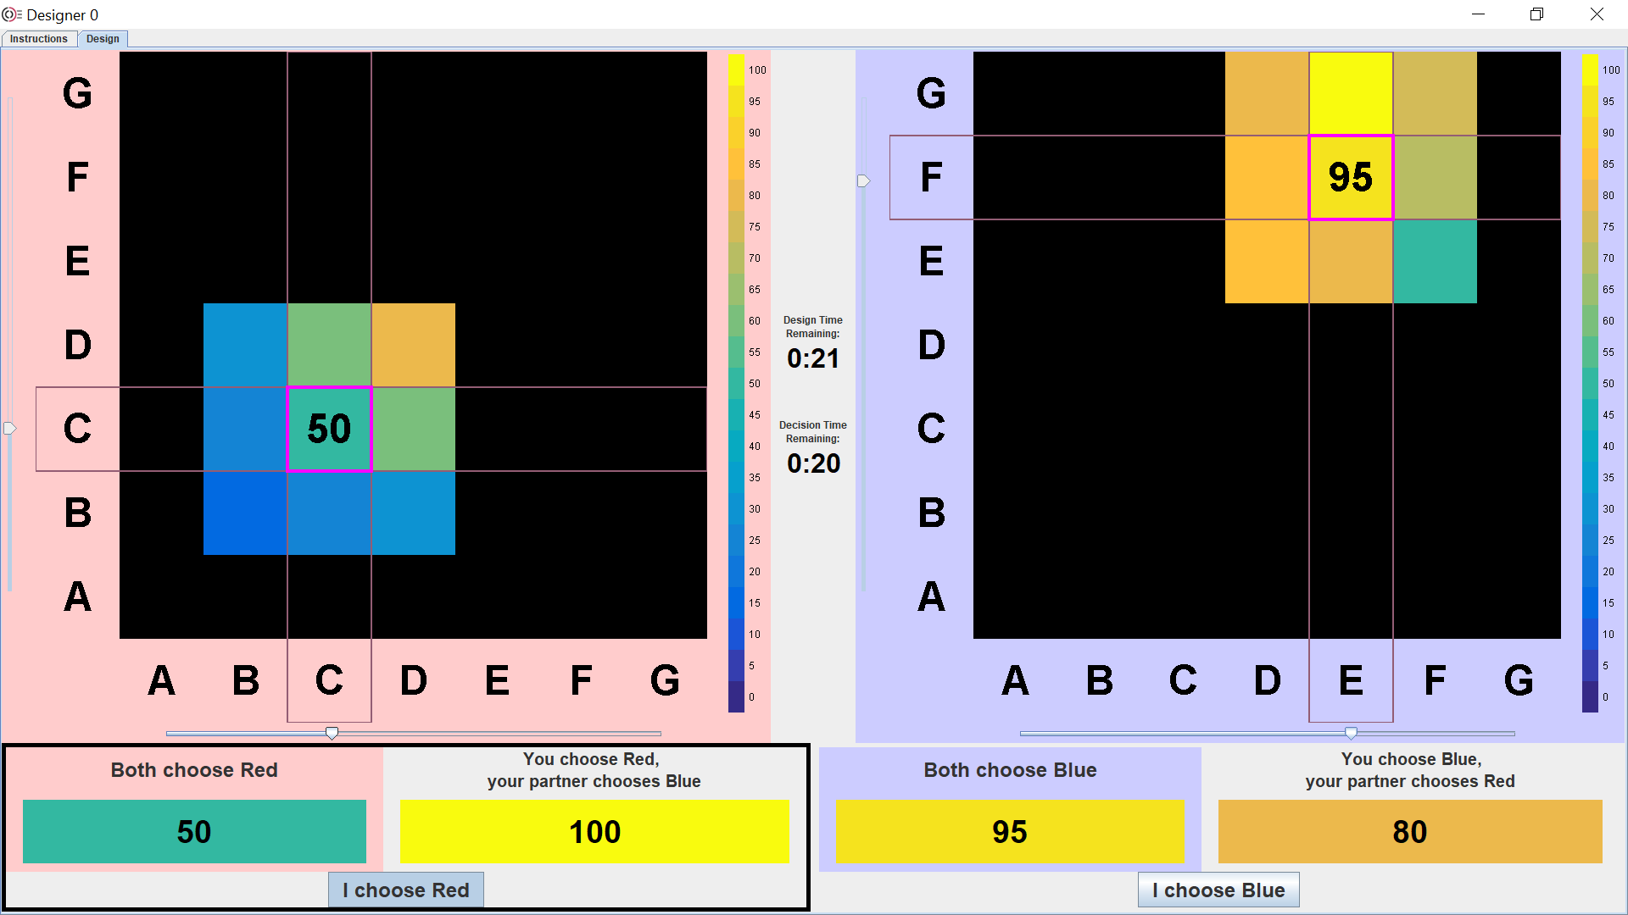

Slide 12
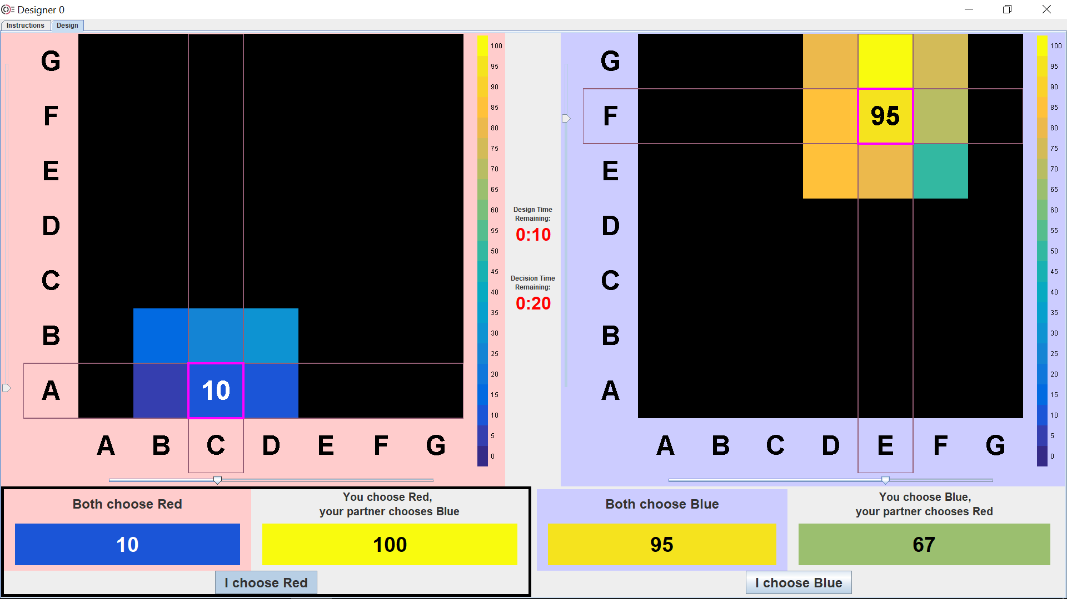

Slide 13


Slide 14
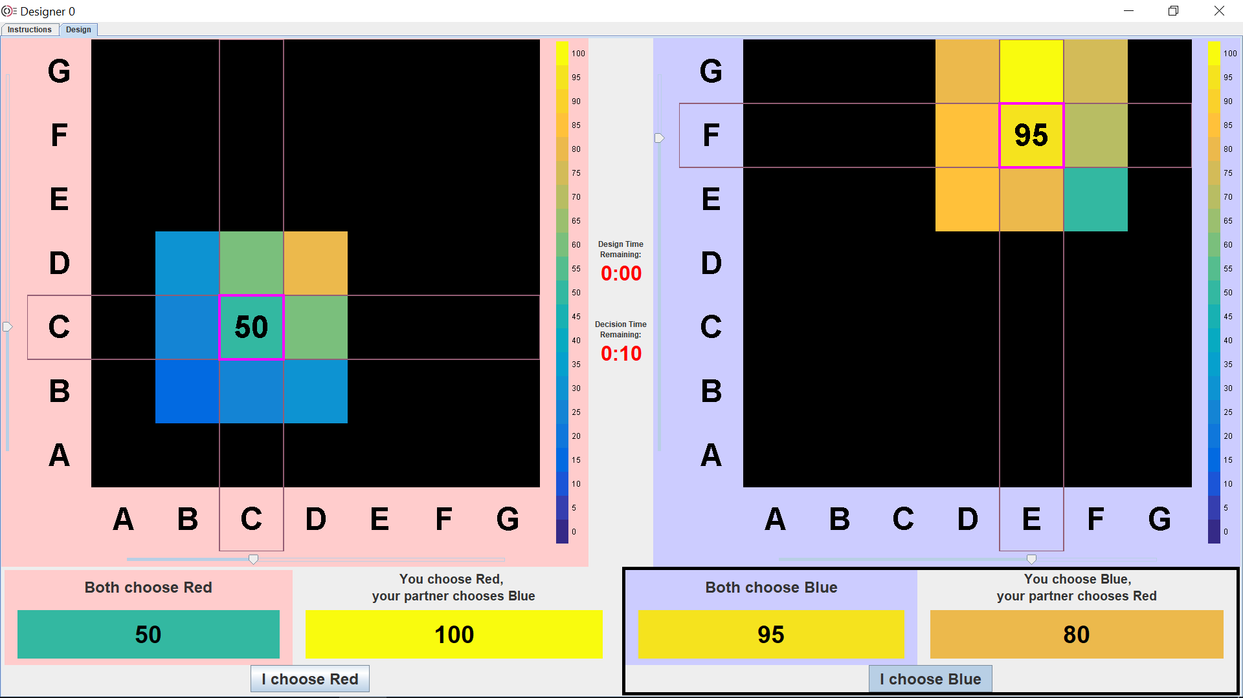

Slide 15
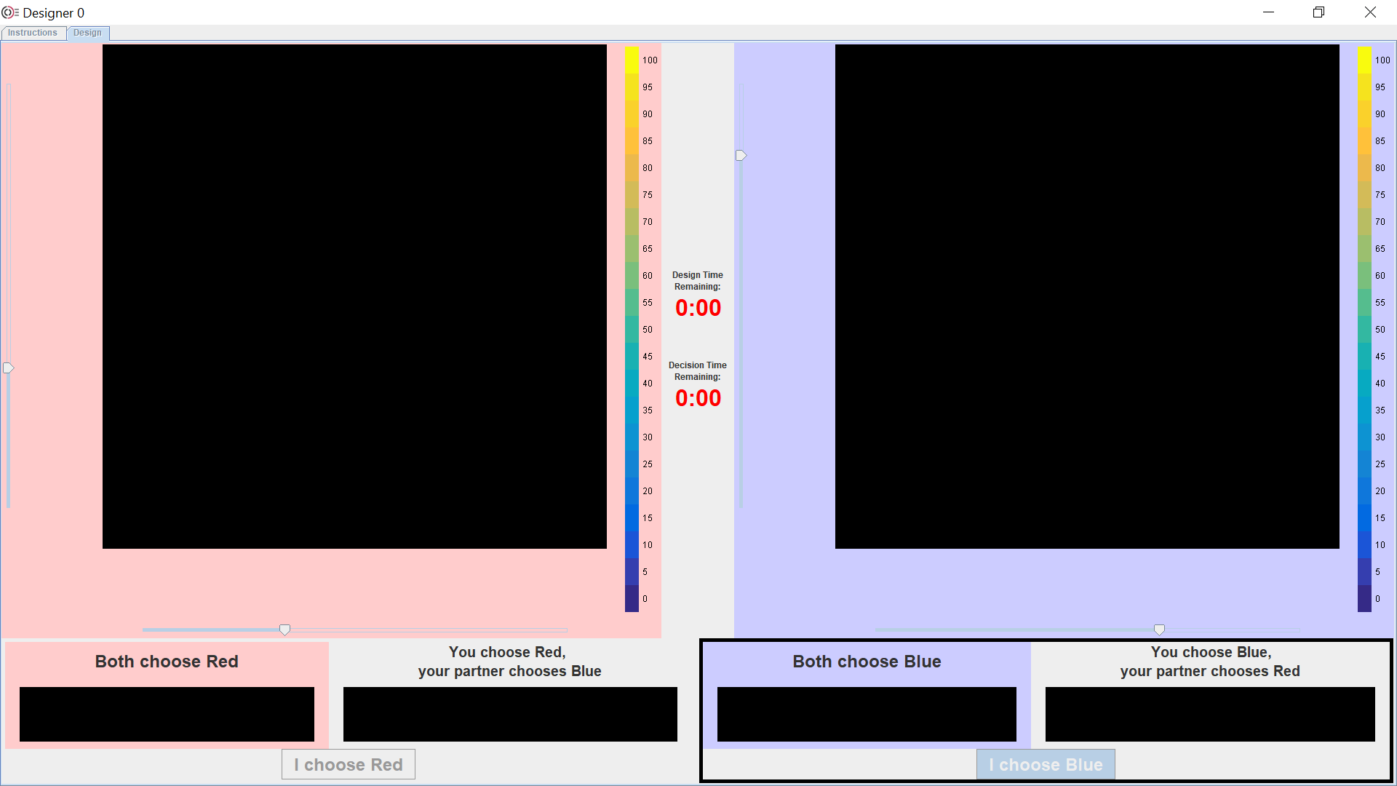

Slide 16
Training 2/3
0
3
A
C
B
D
2
1

Slide 17
Training 3/3
1
0
A
C
B
D
2
3

Slide 18
Task 1/12
1
0
A
C
B
D
3
2

Slide 19
Task 2/12
1
3
A
C
B
D
0
2

Slide 20
Task 3/12
3
1
A
C
B
D
0
2

Slide 21
Task 4/12
2
1
A
C
B
D
0
3

Slide 22
Task 5/12
2
1
A
C
B
D
3
0

Slide 23
Task 6/12
2
3
A
C
B
D
1
0

Slide 24
Task 7/12
0
3
A
C
B
D
1
2

Slide 25
Task 8/12
0
3
A
C
B
D
2
1

Slide 26
Task 9/12
0
2
A
C
B
D
3
1

Slide 27
Task 10/12
0
2
A
C
B
D
1
3

Slide 28
Task 11/12
3
2
A
C
B
D
1
0

Slide 29
Task 12/12
2
3
A
C
B
D
1
0

Slide 30
Paul T. Grogan (PI) pgrogan@stevens.edu (201) 216-5378 | Ambrosio Valencia-Romero avalenci@stevens.edu (201) 989-7160

